Slide 1

CSE- AI & ML
Unit-3
Requirements Engineering
Kedar Pinniboyina
Assistant Professor
AI&ML Department

Slide 2
Problem Recognition
Problem recognition is the process of identifying and clearly understanding a problem in a system before designing or implementing a solution.
Why it Matters
To understand the actual problem before solving it
To avoid wrong or incomplete solutions
To save time, cost, and effort

Slide 3
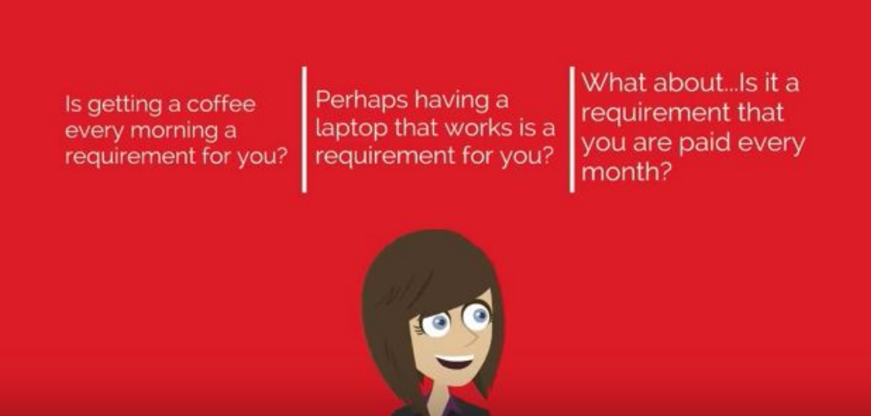
What is Requirement?

Slide 4
What is Requirement?
A requirement is a clear and specific statement that defines a need or expectation that a system or product must satisfy.
It describes what the system should do or the conditions it must meet to be considered complete and successful.

Slide 5
What is Requirement Engineering?
The process to gather the software requirements from client, analyze and document them is known as requirement engineering.
The goal of requirement engineering is to develop and maintain a sophisticated and descriptive System Requirements Specification document.

Slide 6
Requirement Engineering?
It is a four-step process, which includes
Feasibility Study
Requirement Gathering
Software Requirement Specification
Software Requirement Validation

Slide 7
Feasibility Study
A Feasibility Study is a detailed study done before starting a software project to find out whether the project is possible, worth developing within the available time, money, and technology.
It helps management decide whether to start the project or not.

Slide 8
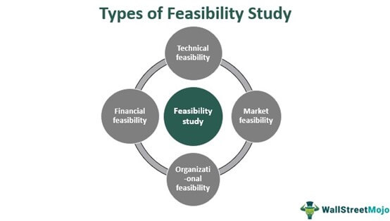
Feasibility Study

Slide 9
Feasibility Study
Main Types:
Technical Feasibility
Checks if required technology and skills are available.
Economic Feasibility
Checks if the project is worth the cost.
Operational Feasibility
Checks if users will accept and use the system.
Schedule Feasibility
Checks if the project can be completed on time.

Slide 10
Requirement Gathering
Requirement Gathering is the process of collecting, understanding, and documenting what the users need from a software system before development starts.

Slide 11
Requirement Gathering
Why Requirement Gathering is Important
Avoids misunderstandings
Reduces rework and cost
Ensures user satisfaction
Helps in proper system design

Slide 12
Requirement Gathering
Types of Requirements in Software Engineering
1. Functional Requirements
These describe what the system should do.
2. Non-Functional Requirements
These describe how the system should work.
3. User Requirements
These are requirements written in simple language for users.
4. System Requirements
These are detailed and technical requirements used by developers.

Slide 13
What is a Stakeholder?
Stakeholders are the people or groups who get affected either positively or negatively — by a company’s decisions, performance, or business situation.
If someone gains or loses because of the company, they are a stakeholder.

Slide 14
Examples of Stakeholder?
Employees:– their jobs and working conditions depend on the organization.
Customers/clients:– they use the product or service.
Investors/shareholders:– they put money into the organization and want returns.
Suppliers:– they provide goods or services.
Communities:- may be affected by company operations.
Government/regulators:– set rules and standards.

Slide 15
Requirement Engineering Tasks
Requirements Engineering is the systematic process of identifying, analyzing, documenting, validating, and managing the requirements of a software system.

Slide 16
Requirement Engineering Tasks
Seven distinct tasks
1. Inception
2. Elicitation
3. Elaboration
4. Negotiation
5. Specification
6. Validation
7. Requirements Management

Slide 17
Requirement Engineering Tasks
These tasks ensure that the software accurately captures, documents, and manages the client’s needs and expectations.
The tasks include:
Inception
Identifying the problem, stakeholders, business goals, and system scope.
It answers why the system is needed and who is involved.

Slide 18
Requirement Engineering Tasks
Elicitation
Gathering requirements from stakeholders through interviews, workshops, questionnaires, observation, etc. It focuses on understanding what users need.
Elaboration
Refining and expanding the gathered requirements into detailed, structured forms (use cases, user stories, models). Ambiguities are clarified here.

Slide 19
Requirement Engineering Tasks
Negotiation
Resolving conflicts among stakeholders’ requirements and prioritizing them based on constraints like cost, time, and feasibility.
Specification
Documenting the agreed requirements formally and clearly, usually in a Software Requirements Specification (SRS) or equivalent artifact.

Slide 20
Requirement Engineering Tasks
Validation
Ensuring the requirements are correct, complete, consistent, feasible, and aligned with stakeholder needs, often through reviews, walkthroughs, and prototypes.
Requirements Management
Handling changes to requirements throughout the project lifecycle, maintaining traceability, version control, and impact analysis.

Slide 21
Requirement Engineering Tasks
Example:
For an online shopping app, tasks include collecting features like login, product search, cart management, and analyzing overlaps with existing systems.
documenting them in SRS; validating with client approval, and updating requirements if the client adds new features.

Slide 22
Software Requirement Specification - SRS
An SRS is a detailed document that explains what a software system should do and how it should behave.
It describes all the requirements, both functional and non-functional, before the software is developed.
In simple words:
SRS = A blueprint or contract between the client and the developers about what the software will do.

Slide 23
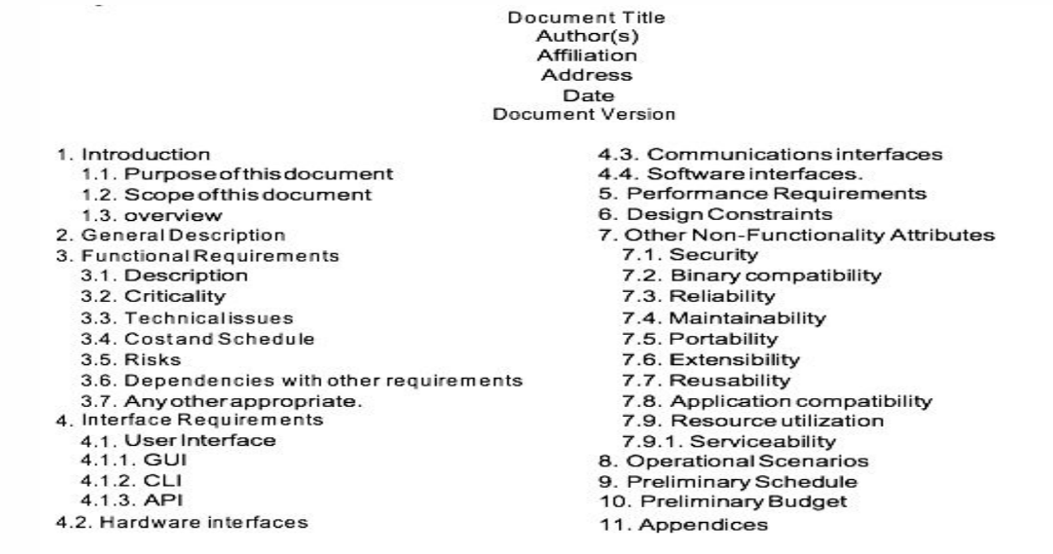
An Example of SRS

Slide 24
An Example of SRS
The SRS serves as a reference for developers, testers, and stakeholders. It includes functional requirements (what the system does) and non-functional requirements (how the system behaves, like performance, security).
Example:
Functional: The system allows users to log in, view marks, and download assignments.
Non-Functional: The system should respond to requests within 2 seconds and be accessible on mobile devices.

Slide 25
Use Cases
A Use Case describes how a user interacts with the system to achieve a specific goal.
Use cases help understand the functional requirements from the user’s side. Each use case defines:
Actor: Who is using the system.
Steps/Scenario: How the interaction happens.
Goal: What the user achieves.

Slide 26
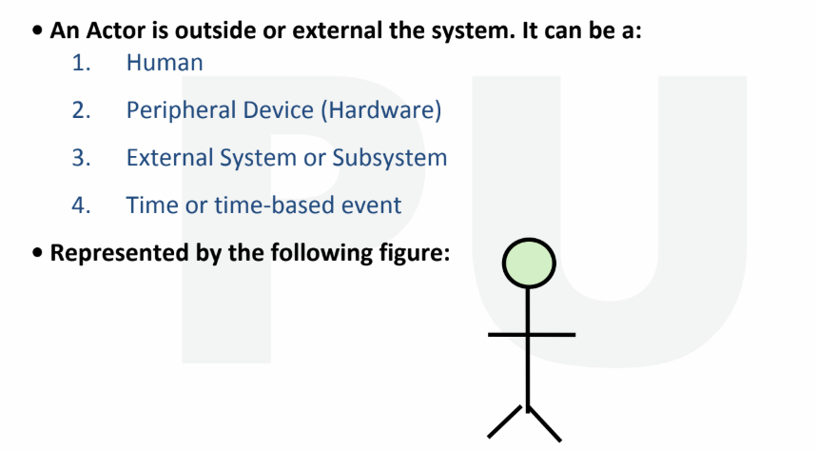
Use cases - Actors

Slide 27
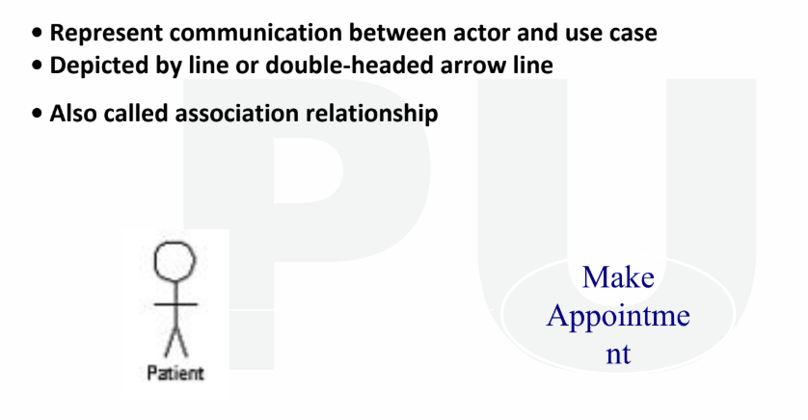
Use cases - Relationships

Slide 28
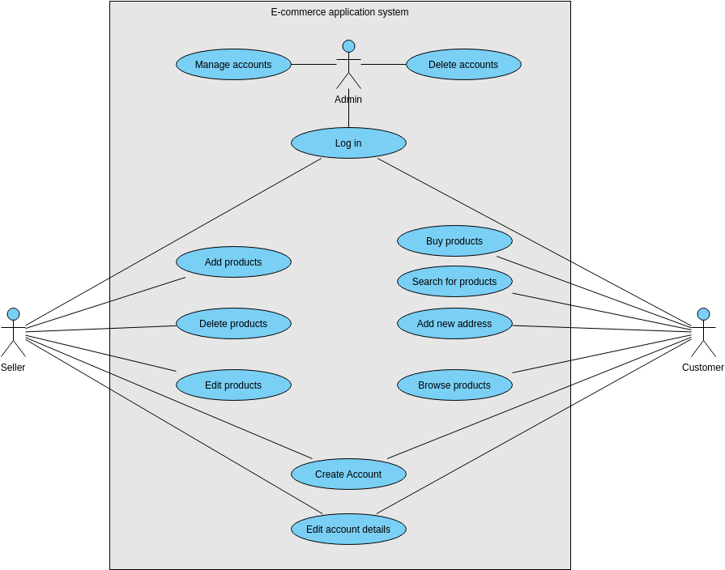

Slide 29
Use Cases
Example:
Use case: “Withdraw Money from ATM”
Actor: Bank customer
Steps: Insert card → Enter PIN → Select amount → Cash dispensed → End session
Goal: Customer successfully withdraws money

Slide 30
Functional Specification
Functional specification is a detailed description of all the functions and features that the system must perform.
Explanation:
It focuses on “what the system should do”. It guides developers in implementing the required functions.
Example:
For an e-commerce website:
The system should allow users to browse products, add to cart, make payments, track orders, and generate invoices.

Slide 31
Requirements Validation
Requirements Validation is the process of ensuring that the documented requirements are correct, complete, consistent, and meet user expectations.
Example:
For an online booking system, validation ensures all requirements such as login, seat selection, payment, and ticket generation work as intended and meet client expectations.

Slide 32
Requirements Validation (Contd.)
Requirement checking can be done in following manner:
1.Validity Checks
2.Consistency Checks
3.Completeness Checks

Slide 33
Validity Checks
CSE- AI & ML
Validity checks ensure that each requirement truly reflects the actual needs of stakeholders and aligns with the business goals. A requirement is valid only if it solves the right problem.
What validity checks look for:
Does this requirement satisfy a real user/business need?
Is the requirement relevant to the project scope?
Did the correct stakeholders approve this requirement?

Slide 34
Consistency Checks
Consistency checks ensure that no requirement contradicts another requirement. All terminology, constraints, and rules must be applied uniformly.
What consistency checks look for:
Do any two requirements conflict?
Is terminology used in a consistent way?
Are rules aligned across the document?

Slide 35
Completeness Checks
Completeness checks usually focus ONLY on missing information, missing scenarios, or incomplete requirements.
However, in requirement validation as a whole (not just completeness), we have additional checks such as:
Realism (Feasibility) Checks
Verifiability (Testability) Checks

Slide 36
Completeness Checks
• Realism checks
Using knowledge of existing technology, the wants should be checked to make sure that they can actually be implemented.
2. These checks should also appreciate the budget and schedule
for the system development.

Slide 37
Completeness Checks
Verifiability
3. To reduce the potential for dispute between the customer and the contractor
4. System requirements should even be written in order that you ought to be ready to write a group of tests that will demonstrate that the delivered system meets each specified requirement.

Slide 38
Requirement Validation Techniques
Requirements Reviews
both the customer and contractor staff should be involved in reviews.
Reviews could also be formal (with completed documents) or informal.
Good communication should happen between developers, customers and users. Such communication helps to resolve problems at an early stage.

Slide 39
Requirement Validation Techniques
Prototyping:-
The requirements can be examined through executable model of system
Test Case Generation:-
If the tests for the wants are devised as a part of the validation process, this often reveals requirements problems.
If a test is difficult or impossible to style , this usually means the wants are going to be difficult to implement and will be reconsidered.
Developing tests from the user requirements before any code is written is an integral a part of extreme programming

Slide 40
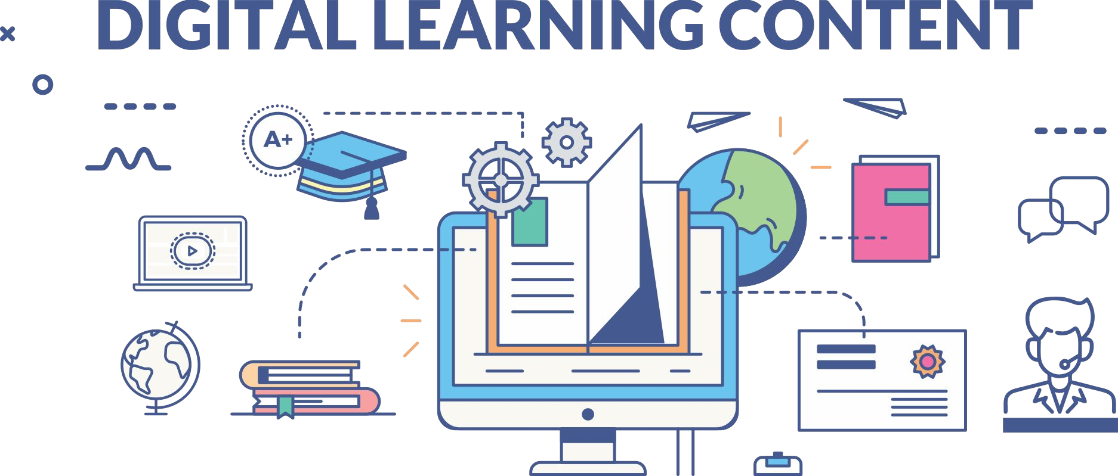

www.paruluniversity.ac.in

